Slide 1

Cajun Toastmasters
December 8, 2022

Slide 2
Cajun Toastmasters Dream
“To create an environment in which we enjoy working together and, as owners, contribute to building a club we can be proud of.”

Slide 3
Toastmasters Mission
“We provide a supportive and positive learning experience in which members are empowered to develop communication and leadership skills, resulting in greater self-confidence and personal growth.”

Slide 4
Today in History! John Lennon Shot 12/08
I'm cynical about society, politics, newspapers, government.
But I'm not cynical about life, love, goodness, death.
That's why I really don't want to be labeled a cynic.
John Lennon

Slide 5
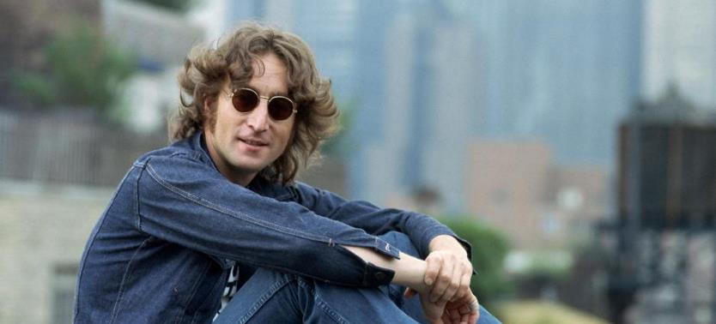
John Lennon

Slide 6

Word of the Week spectacle
Type: noun
Meaning:
A visually striking performance or display
An event or scene regarded in terms of its visual impact
Sentence: “When you do something noble and beautiful and nobody noticed, do not be sad. For the sun every morning is a beautiful spectacle and yet most of the audience still sleeps.” ― John Lennon

Slide 7
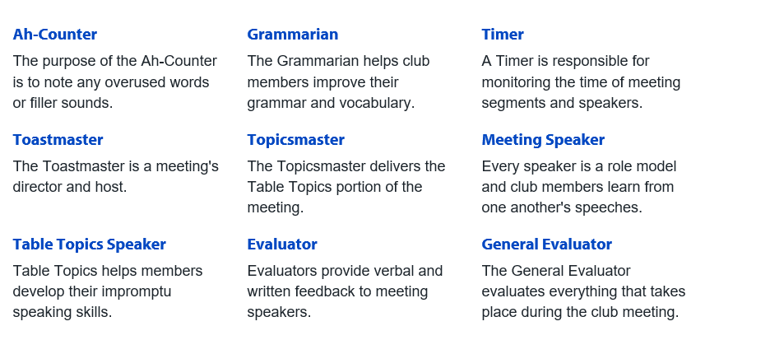
Roles Overview

Slide 8


Roles

Slide 9

Toastmaster – Angie Davis Rincon
Table Topics – Angie Davis Rincon
Timer – ?
Agh Counter – ?
Grammarian – ?
Speech – ?
Speech Evaluator – ?

Slide 10
Speech #1

Slide 11
Speech #2

Slide 12
Speech #3

Slide 13
Table Topics

Slide 14
Yell Out (One person will yell out a word that you have to incorporate)
Your day at the beach
Your day at work
Your first holiday with your inlaws or friends
Your favorite sport or activity

Slide 15
Guess It
Speaker will feel and describe an object
The audience has to guess what it is
Notes:
Mirror; toy; cotton ball; lotion; candy; hair comb; socks

Slide 16
Table Topics
What music were you exposed to as a child?
How did you feel about your Spotify wrapped?
Do you have a go-to karaoke song?
What’s your favorite live music memory?
What artists got your through your teen years?
Tell us about the music of your region.
What kind of musical education did you receive?
Did your parents sing to you? If so, what?

Slide 17
Ballot Vote

Slide 18
Speech
Evaluation

Slide 19
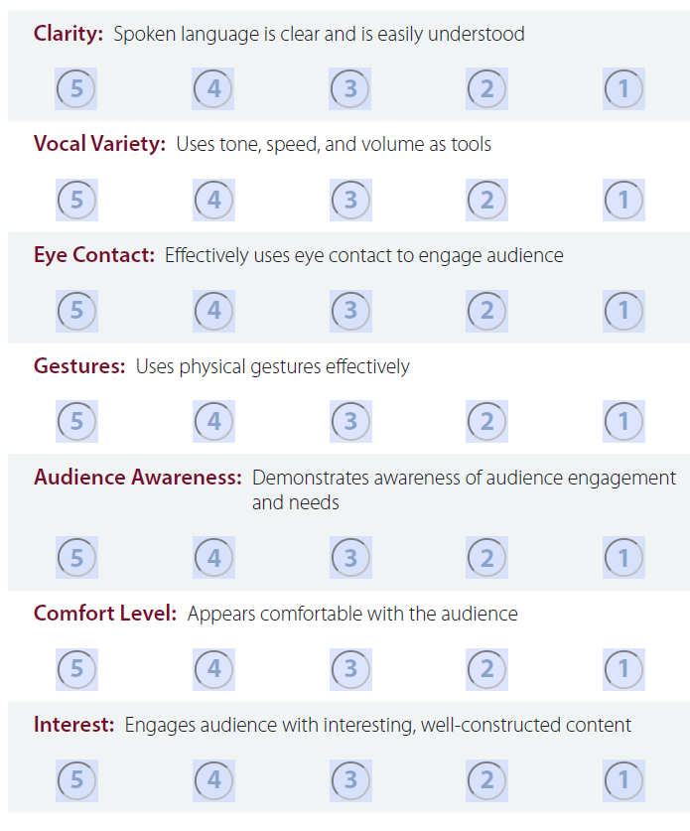
Speech Evaluation
Clarity
Vocal Variety
Eye contact
Audience Awareness
Gestures
Comfort level
Interest
Notes:
Working on this for next 2-3 months

Slide 20
Group Collaboration –
Microsoft Teams (dedicated time)

Slide 21
Meeting Evaluation

Slide 22
Meeting Evaluation
Ah Counter
Grammarian
Timer
General Evaluator

Slide 23
Table Topics Winner

Slide 24
Nov Speech Schedule
 | Speakers | Evaluators | Toastmaster
Dec 15th
Dec 22nd
Dec 29th

Slide 25
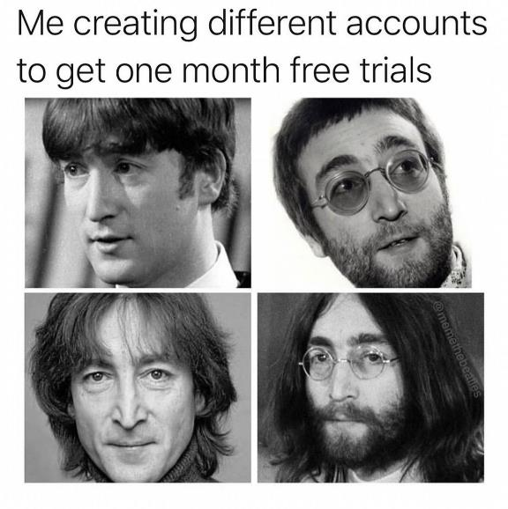
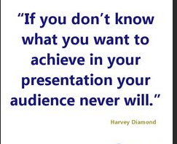

Slide 26
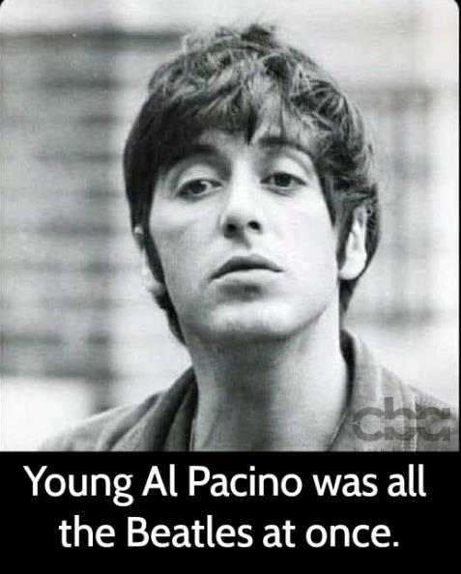

Slide 27
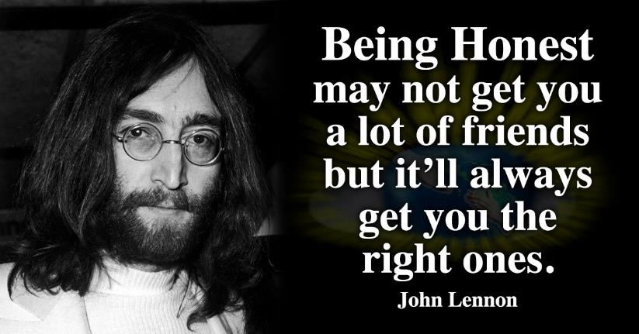

Slide 28
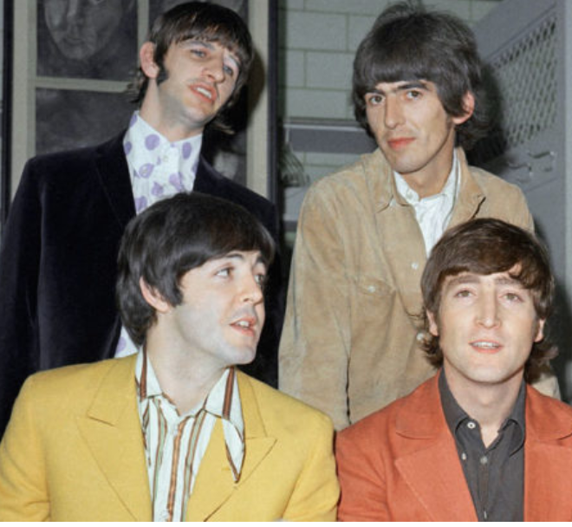

Slide 29
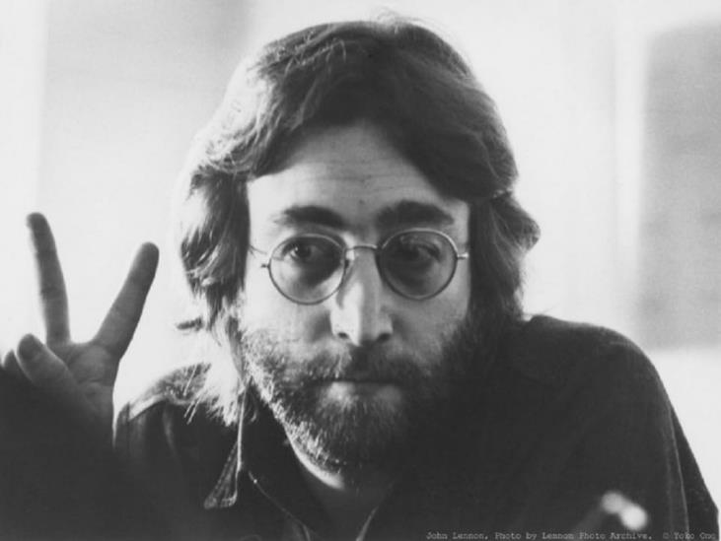

Slide 30
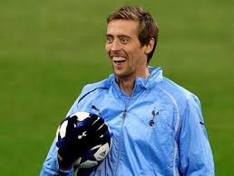
Football is almost here!!

Slide 31
Actions
Open House

Slide 32
Let’s Discuss Your Pathways
Blake-Innovative Planning
Meredith-Visionary Communication
Billie-

Slide 33
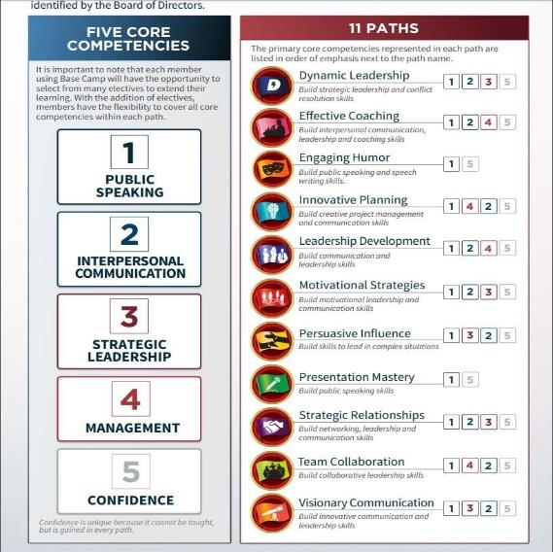
Pathways Overview

Slide 34
Thank you!
I’m excited to be part of Cajun Toastmasters and I appreciate you guys having me!
12.8.22 Toastmaster: Angie Davis Rincon

Slide 35
Cajun Toastmasters
December 8, 2022

